Slide 1





Mantid: Lessons from the Long Haul
Martyn Gigg
NOBUGS
Brookhaven National Laboratory
October 22-26 2018
Notes:
Introduce self and where you’re from.

Slide 2
Overview
Set the scene: introduce project & history
Lessons:
Technical
Non-technical
Closing remarks
Notes:
Describe structure and intent of talk

Slide 3
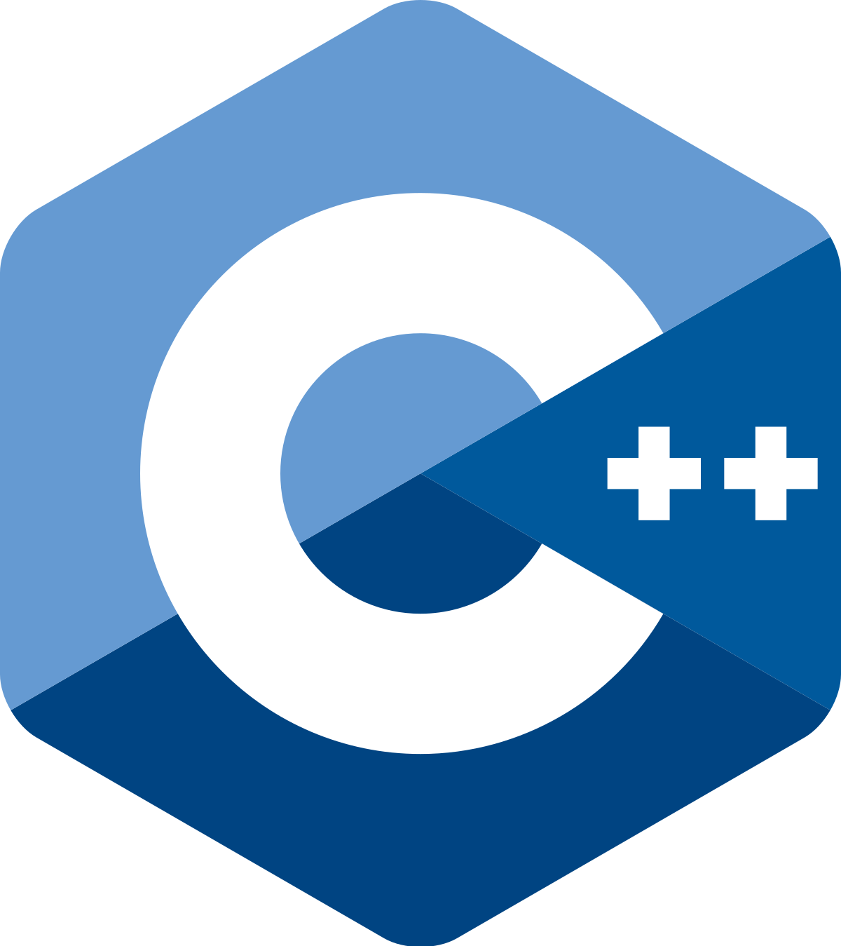



Mantid: Background
Event
Data
Live Data
Histogram Data
Neutron
Muon
Notes:
Open source, cross-platform data reduction & analysis framework for neutron & muon data
C++/Python
OpenMP
Histogram and event data support
Multi-dimensional data structures
Live-data reduction enabled
Qt-based graphical user interface:
Plotting
Fitting
Full 3D instrument rendering
2D/3D data visualization tools

Slide 4
Mantid: Timeline
2007
2010
2014
2016
1 instrument
> 50 instruments
plus non-partner users/contributors
Notes:
2007: Project begins in earnest at ISIS to support a single instrument
2007-2010: Expansion to multiple instrument support at ISIS
2010: A collaboration was set up between ISIS and ORNL to jointly develop Mantid for support at ISIS, SNS, HFIR
2014: ESS decide to use Mantid as the reduction framework when ESS comes online
2016: ILL joins and starts to implement additional support for reactor facilities
Non-partners: MLZ (Julich), SINQ (PSI), ANSTO

Slide 5
Challenges
Environmental
Code Quality
Development Workflow
Developer Communication
Support/QA
User Communication
Notes:
Technical:
Code quality
Development workflow
Environmental: the world (software) is changing around you
Communication - Developer and User
Support/QA
Communication:
Initially all developers in the same room or adjacent rooms. Now developers in different time zones.
Aim to share as much as possible for same techniques at different facilities. Users are now distributed.
Requirements gathering is much hard

Slide 6






Code Quality: SCM, Issue Tracking & CI (Oh My)
Then:
Now:
Notes:
THEN
Initially Subversion, Trac, Cruise Control. All self-hosted
Commit to trunk.
I refer to it as the “Wild West”
The Good:
Version control existed from the start - traceability
Feedback for if something was broken from builder
Links to source of feature requests
Not so Good:
Build checks done on trunk so not really CI
Maybe the odd branch
No code review before hitting trunk - less likely to change anything
No easy way to track warnings etc
Setup in 2008 works with very small number of developers all near the server
It does not scale
NOW
Distributed project requires a much improved structure.
First moved to Git/GitHub/Jenkins with single built development branch and limited code reviews

Slide 7
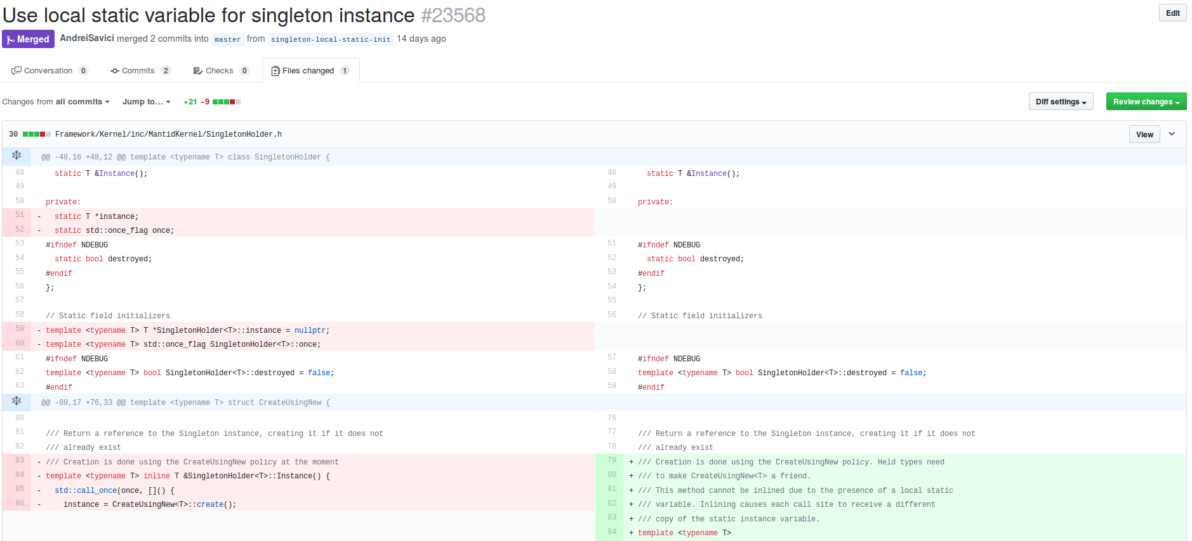
Code Quality: Code Review
Vital tool to improve code quality
Done before hits master!
Fresh eyes are always helpful
Traceable for future reference
Difficulties when developing larger features
Notes:
Be nice! We’re all on the same team and everyone is doing their best
Conversational tone: Try “Have you considered” or “Can we use X instead” rather than “This should use X”
Try and avoid wanting the code to be written “exactly” as you would have written it. Is it fit for purpose, maintainable?

Slide 8

Code Quality: Testing
It’s a first class citizen!
Both manual & automatic
Unit testing, integration testing, system testing
Document it!
A single TDD (test-driven development) course changed my view of unit testing
Notes:
Ensure your tests are good quality and treat them like the code they are testing them
Check them in code reviews
Still feel tests are not quite taken as seriously as code.
I remember learning about TDD and thinking how have I lived without this!
I still have to stop myself from wanting to write code before tests.
Ensure system tests don’t go stale

Slide 9
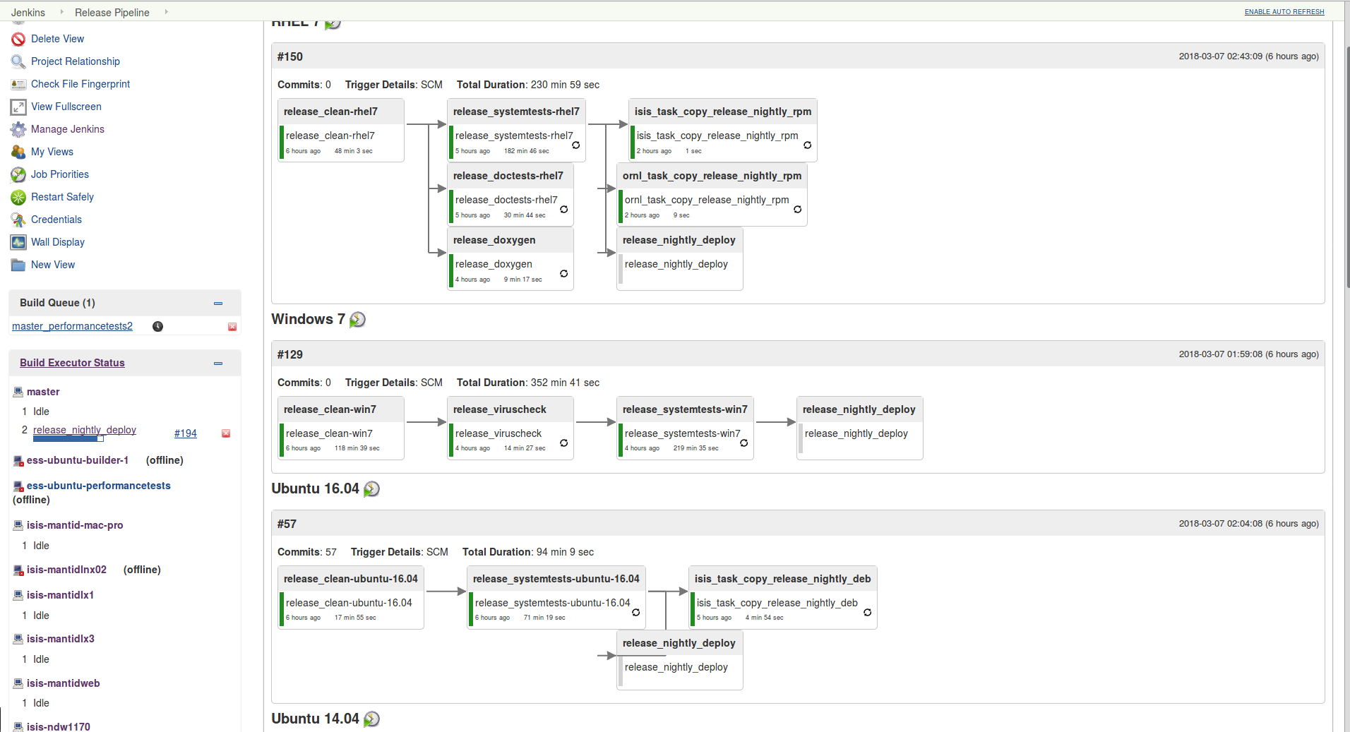
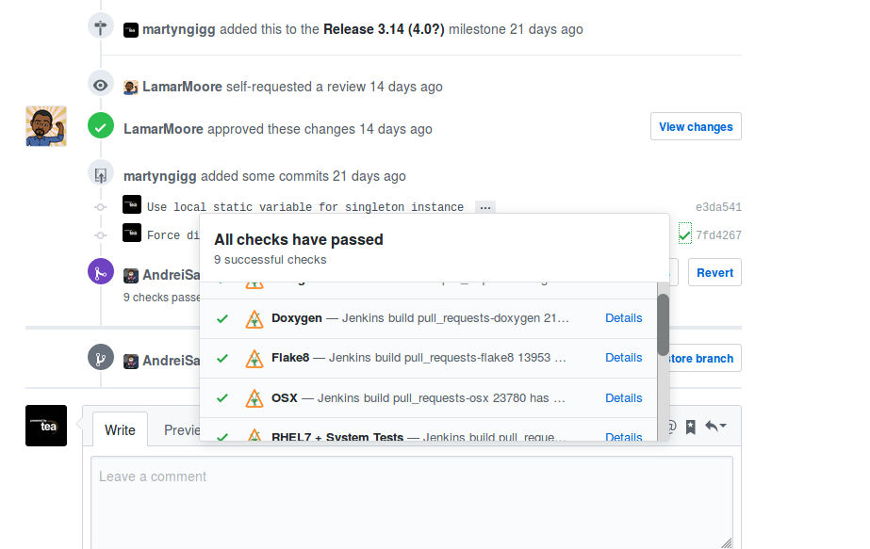
Code Quality: CI
CI should check more than just the code builds
Run automated tests
Listen to warnings from compilers!
Use static analysis
Fix unreliable tests as soon as you see them
Keep up with new tools as they become available
Notes:
CI: Continuously Integration is about continually ensuring your code is merged with the mainline branch
Avoid long-running branches (with the exception of release branches)
Fits well with agile methodologies of releasing more frequently
Setup static analysis early and keep warnings at 0. Hard for new devs to understand why “12” is fine but “13” is not.
Static analysis recently allowed us to find/fix some unreliable tests that would have taken a very long time to track down without the tools
Visualize your deployment pipeline
Script as much as possible
Take care with scripts - we accidentally released a version early because of a CI misconfiguration

Slide 10
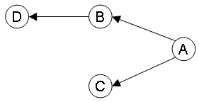

Dependencies
Dependencies change
Isolate 3rd party dependencies where possible
Lowers risk that api changes affect everything
Vet them (both code and functionally)
Recently bitten:
Qt-based application required a package that was Qt4 only
Qt5 based version of package was available but api had changed enough to require changes to all nearly call sites.
Old GUI code -> no tests
Decision was taken to create another application from scratch
Notes:
Environment for software is not static. Dependencies change over time too.
If you are integrating your software into another, forking it, take a serious look at things like code quality and not just functional requirements.

Slide 11


Communication: Development Team
Setting up Slack doesn’t mean your done with communication
Tools:
Slack for day-to-day chat
Bluejeans for video conference
Daily team stand ups
Fortnightly developer team video conference:
Announcements
Pick topic and delve into more depth to spread knowledge
Annual face-to-face developer meeting with code camps
Vital to meet face to face
Retrospectives on sprints/release cycles
Notes:
Skype was the “answer”.
Weekly catch up for group leads. Use time to hopefully catch possible duplicate work
Takes real time and effort to properly agree and implement true common workflows

Slide 12

Communication: Users
Software should aim to serve its users
“No one wants to use your software...”
Good communication channels with users is key
Requirements gathering is tricky
Probably one of our most challenging tasks
Only have 1 meeting a year where users from different facilities are in the same room
Define “owners” of features. Have them commit to testing/verification
Developers need to have a very good understanding of the science
Communicate with counterparts at other facilities
Notes:
Users are trying to achieve a goal, don’t get it in there way
Aim to have as much shared code/workflow as possible across facilities

Slide 13
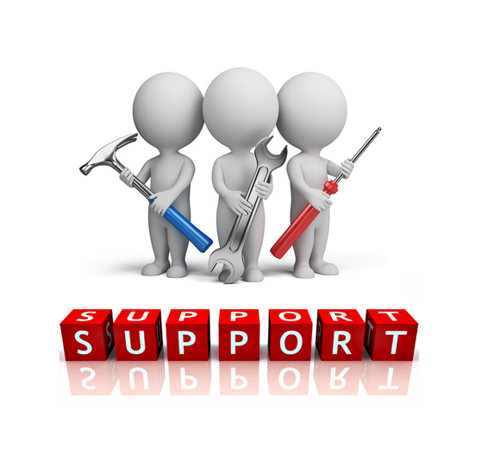
QA/Support
Developers != (necessarily) good testers
Often blinded by knowing things too well
Review PRs from other areas of system
Developers supporting users may cause lots of context switching → slowing development
As user-base expands more time naturally needs to be devoted to support
We didn’t think about this early enough
ISIS now has 1 person dedicated to support. Sub teams per technique
ORNL has 20% developer time devoted to support. Developer embedded 1->3 beamline teams
Notes:
We didn’t think about this early enough
Support person has more time to understand what users do and issues that arise
Has less of a developer-mindset when testing functionality

Slide 14
QA/Support
User error reports can often be unreliable
Error reporting system
Feature tracking allows to confirm usage or lack of usage of features
Ask permission!
GDPR

Slide 15
Summary
Use tools and listen to them
Take time to address code quality issues
Effective communication is one of the hardest things to keep under control as you grow
Easy to kid yourself that it’s happening
Consider a dedicated tester/support person as user-base grows

Slide 16

Who has the first question?

